Slide 1
Hospital-based HTA and AdHopHTA Adopting hospital-based Health Technology Assessment in the EU

Slide 2
What is hospital-based HTA or HB-HTA ?
Hospital-based Health Technology Assessment (HB-HTA) means performing HTA activities tailored to the hospital context for managerial decisions.
It includes the processes and methods used to produce HTA reports “in” and “for” hospitals.
Definition developed by the partners of AdHopHTA

Slide 3
Why hospital-based HTA or HB-HTA ?
An ever increasing stream of new health technologies claims to have the potential to solve many of the current challenges in healthcare and provide answers to unmet health needs
Hospitals are generally the entry point for new and innovative technologies
HB-HTA is a tool for supporting managerial decisions in the hospital regarding health technologies

Slide 4
Why hospital-based HTA or HB-HTA ?
HB-HTA is based on scientific knowledge and relevant hospital-specific information
It is objective and targeted to a specific context
HB-HTA makes it possible to take better-informed decisions supporting effective, safe and sustainable healthcare for a hospital
It facilitates better investment decisions allowing hospitals to become more efficient by avoiding inappropriate investments or by reducing unnecessary use

Slide 5
3+1 reasons for adopting HB-HTA
HB-HTA leads to sound investment decisions contributing to improved hospital efficiency
US$ 370K improved efficiency
from decrease in unnecessary lab tests
US$ 3M improved efficiency from 16 HB-HTA reports
❶
❻
HB-HTA provides the information needed for decision-making
-year performance of an HB-HTA unit
❷
100% satisfied
hospital decision-makers by 5-year activity of an HB-HTA unit
❸
HB-HTA is used by hospital decision-makers
>90%
of recommendations from HB-HTA reports adopted in 4 studied hospitals

Slide 6
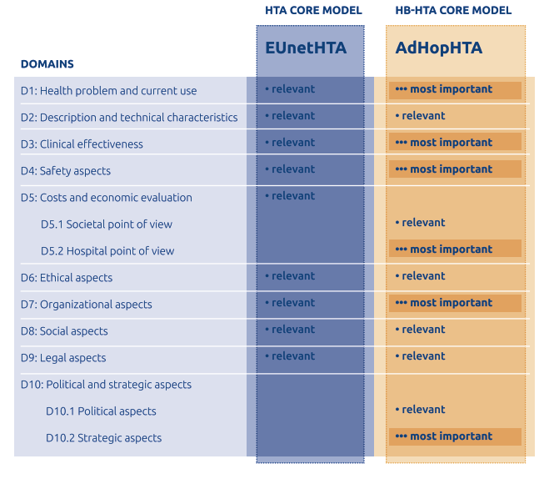
3+1 reasons for adopting HB-HTA
+1
HB-HTA answers
informational
needs of hospital
decision-makers

Slide 7
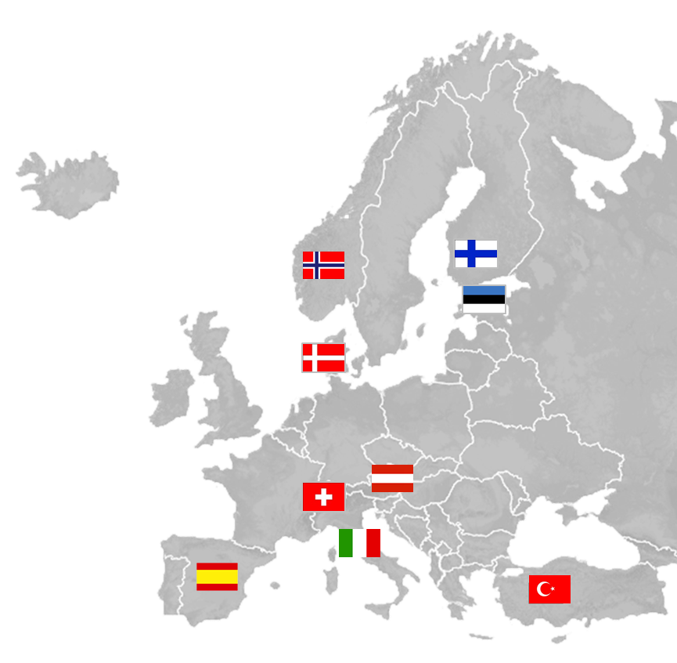
The AdHopHTA project
The aim of the project is to:
Make available pragmatic information, knowledge and tools
Facilitate the adoption of hospital-based HTA initiatives
Contribute to building an European ecosystem for HTA “in” and “for” hospitals
7 University Hospitals
2 HTA Agencies
1 Business school
NOKC
HUS
TUH
OUH
Project
Consortium:
CHUV
LBI-HTA
UCSC
FCRB
ANHTA
IESE

Slide 8
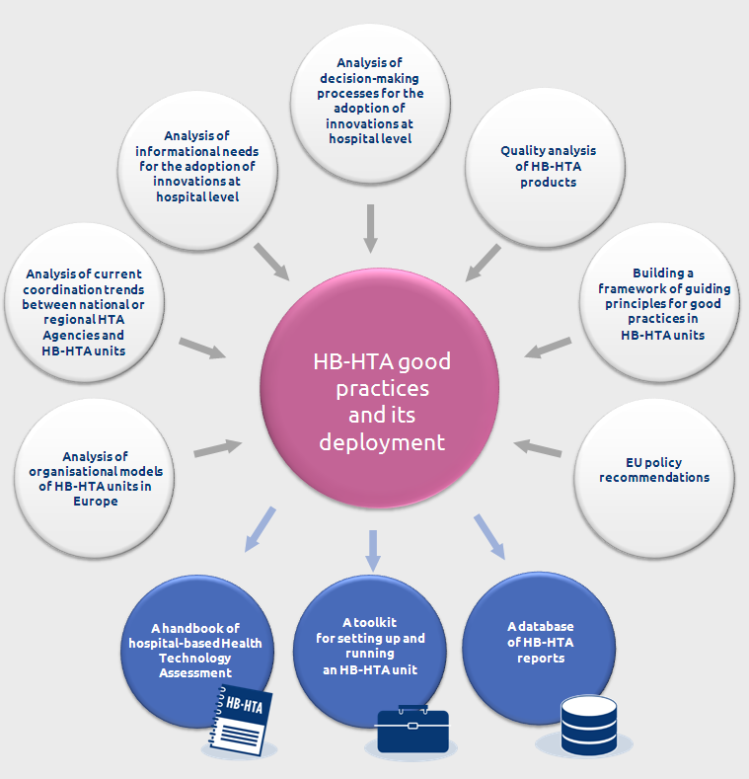
AdHopHTA project activities and outputs
6 literature reviews
107 face-2-face interviews
40 case studies
Large-scale survey = 163 respondents
Focus group = 8 participants
Delphi process = 36 participants
Validation workshop = 11 panellists
385 people
from 20 countries provided their input (345 external to the consortium)

Slide 9
The AdHopHTA handbook
Provide information (from evidence, research under AdHopHTA project ) and knowledge (from project consortium experience)
Support the development of an evidence- and knowledge-based decision-making process for
organising and performing HTA “in” and ”for” hospitals
management of health technologies in hospitals
Special emphasis on how to set up and develop an HB-HTA unit

Slide 10
The AdHopHTA handbook
Key content
detailed information on what HB-HTA is
how hospitals are using HB-HTA to manage health technologies
current organisational models of HB-HTA
content, formats and quality of HB-HTA reports
collaboration with national/regional agencies
guiding principles for good practices in HB-HTA units

Slide 11
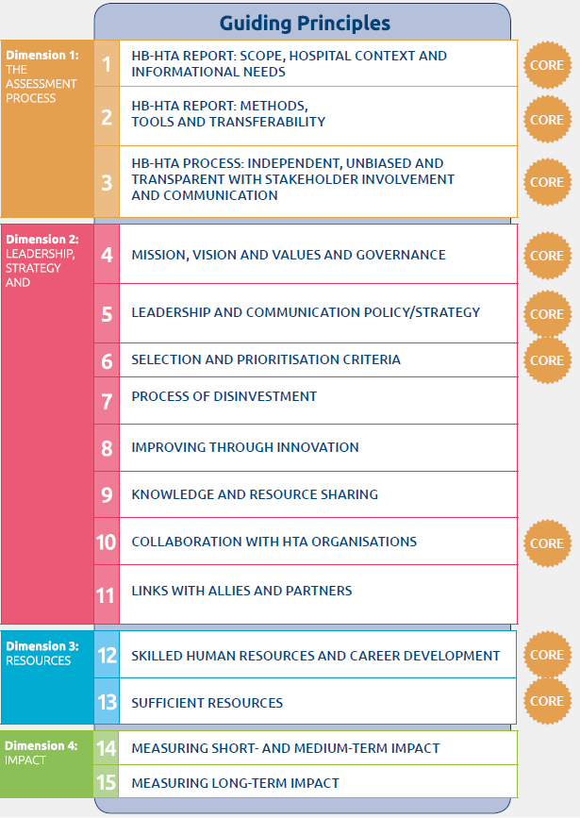
Guiding Principles for organising and performing
HB-HTA
15
Guiding principles
9
Core guiding principles

Slide 12
The AdHopHTA toolkit
Aim
Guidance and tools facilitating the pragmatic application of the guiding principles for good practices for organising and performing HB-HTA
Addressed to hospitals willing to set up or improve an HB-HTA unit, initiative or programme
Based on research from the AdHopHTA project

Slide 13
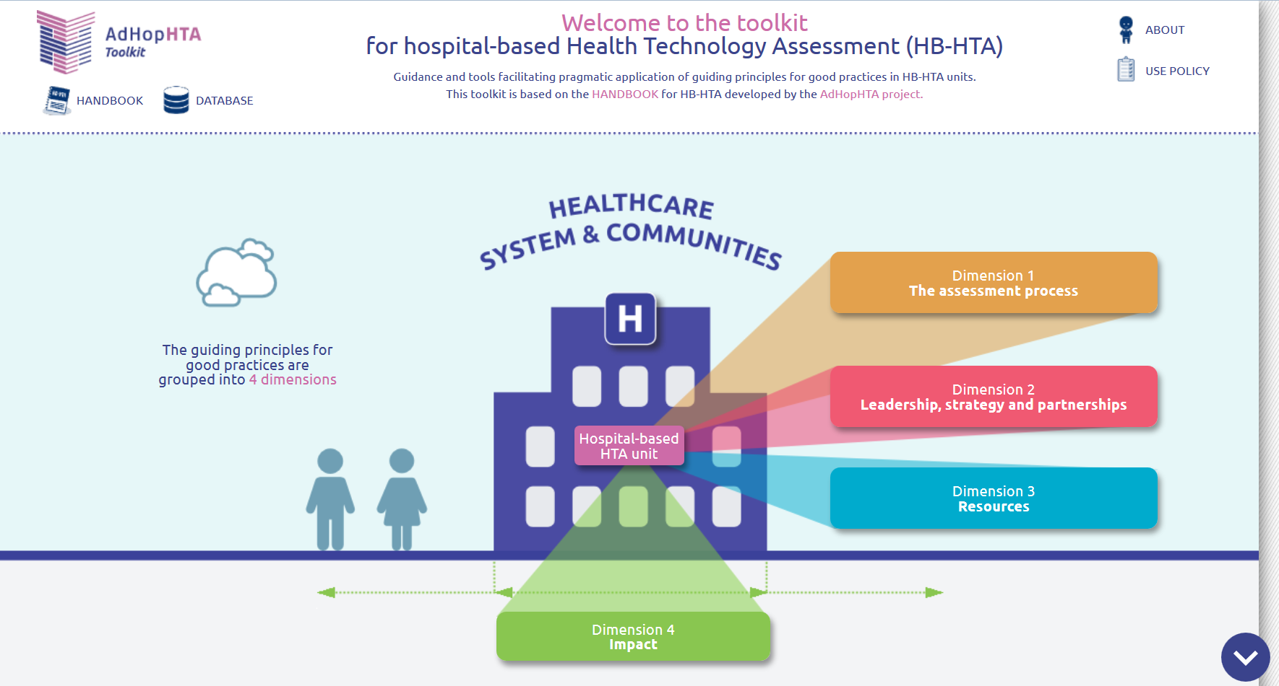
The AdHopHTA toolkit
www.adhophta.eu/toolkit
34
tools

Slide 14
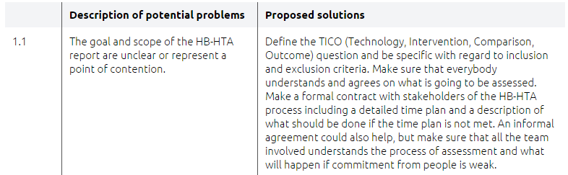
The AdHopHTA toolkit
www.adhophta.eu/toolkit

Slide 15
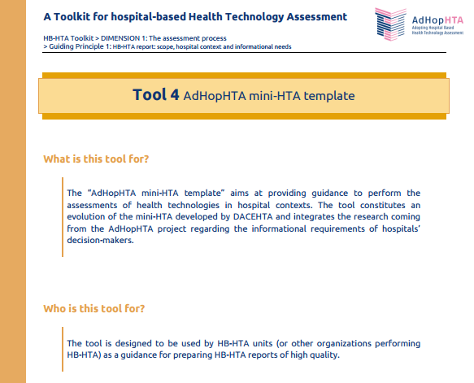
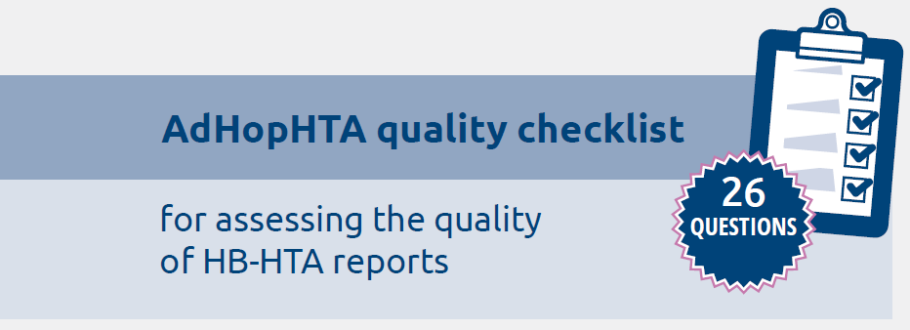
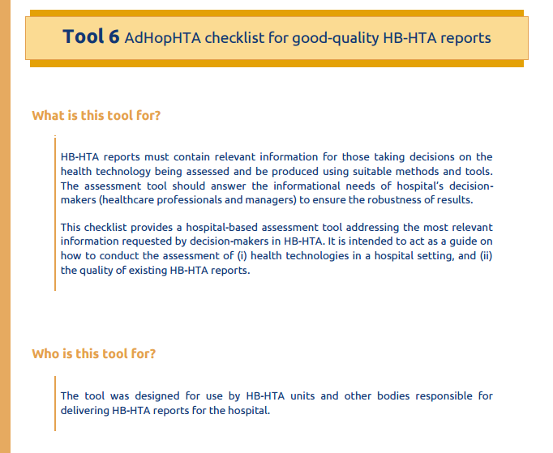
The AdHopHTA toolkit

Slide 16
The AdHopHTA database
Aim
Online source of information on hospital-based HTA reports produced by (partner) hospitals
Allows the access to and exchange of knowledge about specific health technologies
Promotes networking

Slide 17
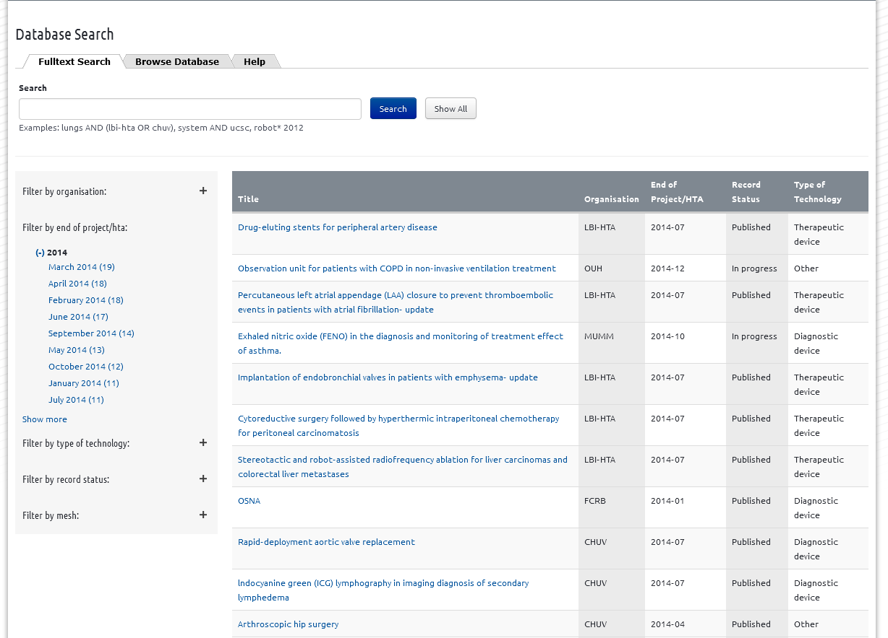
The AdHopHTA database
219
entries

Slide 18
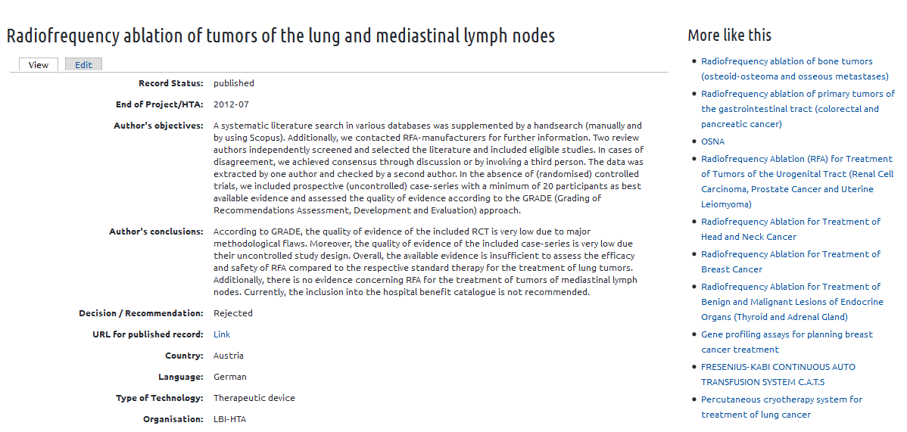
The AdHopHTA database

Slide 19
The AdHopHTA consortium
COORDINATOR
Hospital Clínic de Barcelona/Fundació Clínic per a la Recerca Biomèdica – Spain
Contact: Laura Sampietro-Colom
PARTNERS
Graduate School of Health Economics and Management, Università Cattolica del Sacro Cuore/University Hospital
“A. Gemelli“ – Italy
Contact: Americo Cicchetti & Marco Marchetti
Odense University Hospital – Denmark
Contact: Kristian Kidholm
University of Helsinki and Helsinki University Hospital – Finland
Contact: Iris Pasternack, Risto P. Roine
Norwegian Knowledge Centre for the Health Services – Norway
Contact: Brynjar Fure
Center for Research in Healthcare Innovation Management, IESE Business School – Spain
Contact: Magdalene Rosenmöller
Ludwig Boltzmann Institute for Health Technology Assessment – Austria
Contact: Claudia Wild
Ankara Numune Training and Research Hospital – Turkey
Contact: Rabia Kahveci
Centre Hospitalier Universitaire Vaudois – Switzerland
Contact: Jean-Blaise Wasserfallen
Tartu University Hospital – Estonia
Contact: Raul – Allan Kiivet, Margus Ulst

Slide 20
How to access the AdHopHTA products
www.adhophta.eu
Handbook of HB-HTA
Toolkit for setting-up and running an HB-HTA unit
Database of
HB-HTA reports

